Slide 1
Music Genre Classification
Done by :
Abd Alrhman Bolad Maya Chalabi
Raghad
Lamia Alariqi
Zaid Allwansah

Slide 2
Table of contents
01
02
03
04
05
Prepare the data
Introduction
Explore the data to gain insights.
Train different models
Evaluation and solution.

Slide 3
01
Introduction
The main aim of this problem
is to predict Genre of the track. This problem comes under supervised Machine Learning Classification

Slide 4
Dataset Description
Training Dataset
Total Rows: 14,395
Total Columns: 18
Loudness: Overall loudness of the track in decibels.
Mode: Modality of the track (major or minor).
Speechiness: Presence of spoken words in the track.
Acousticness: Likelihood of the track being acoustic.
Instrumentalness: Likelihood of the track being instrumental.
Liveness: Presence of an audience in the recording.
Valence: Musical positiveness of the track.
Tempo: Beats per minute of the track.
Duration (ms): Length of the track in milliseconds.
Time Signature: The number of beats in a measure.
Column Details:
Artist Name: Name of the artist.
Track Name: Name of the music track.
Popularity: Popularity score of the track.
Danceability: Measure of how suitable a track is for dancing.
Energy: Intensity and activity level of the track.
Key: The musical key of the track.

Slide 5
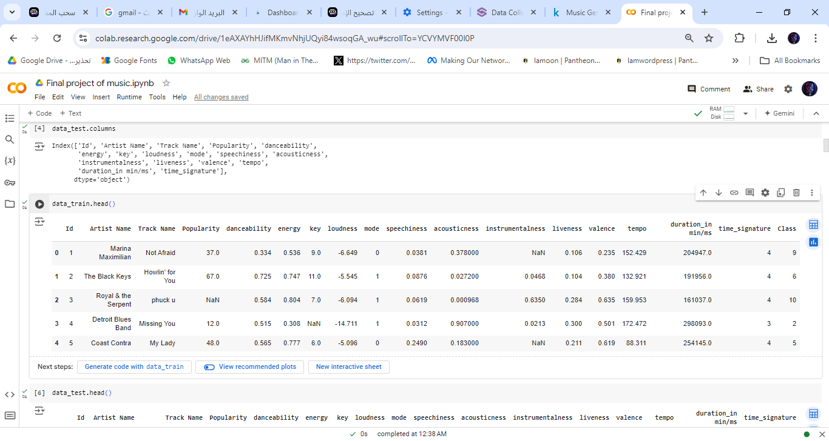
Display of Dataset Columns

Slide 6
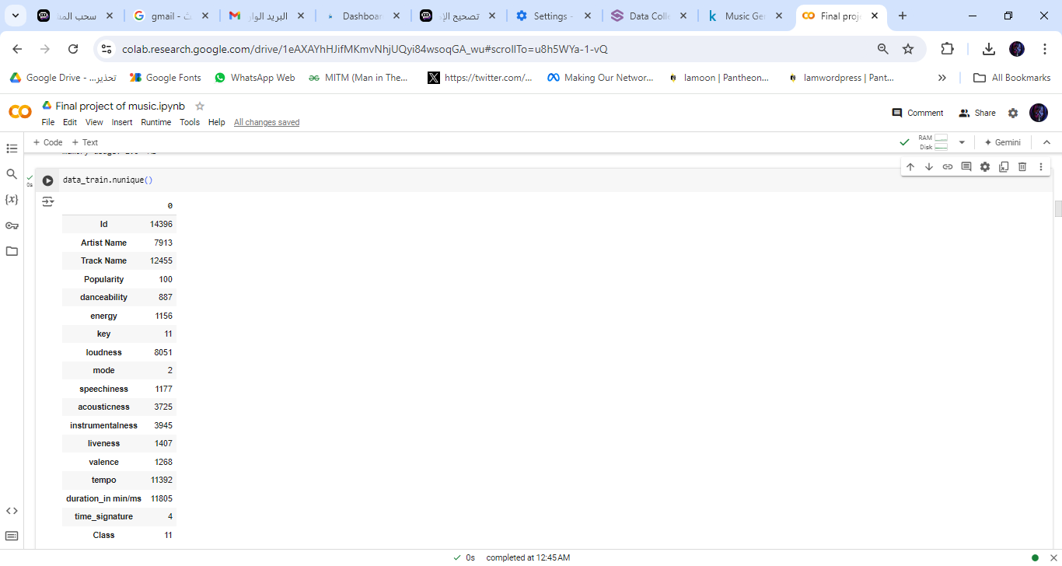
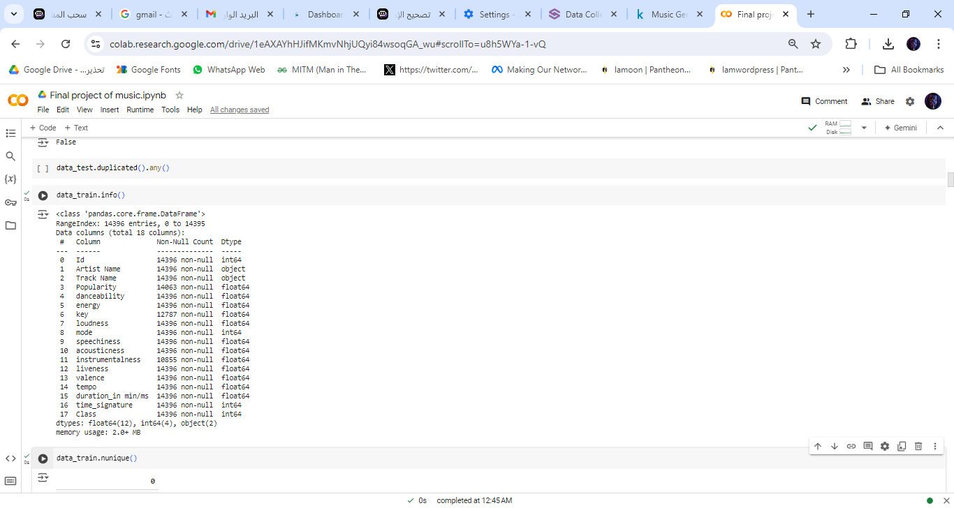
return the count of unique values for each
column in the data_train DataFrame.
provide a concise summary
of the data_train DataFrame.

Slide 7
02
Explore the data to gain insights.

Slide 8
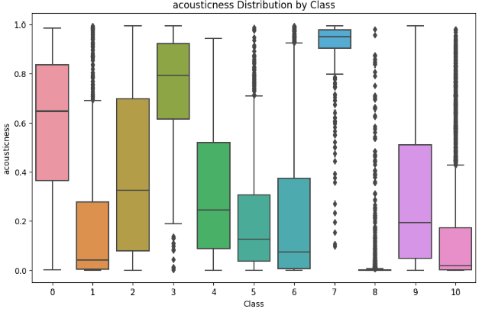
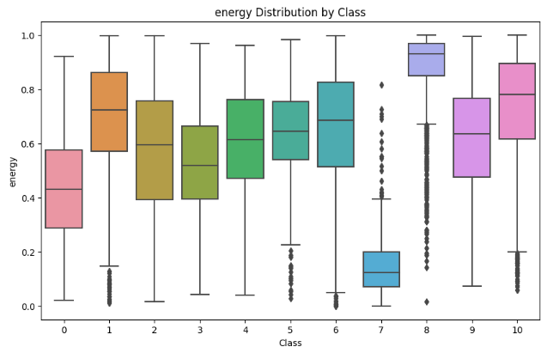
Visualize key features

Slide 9
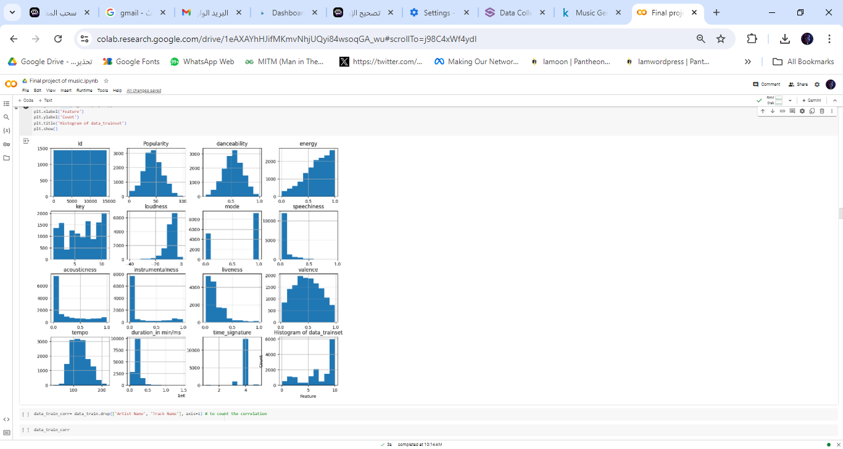
Visualize distribution of all the variables in the data using histograms

Slide 10
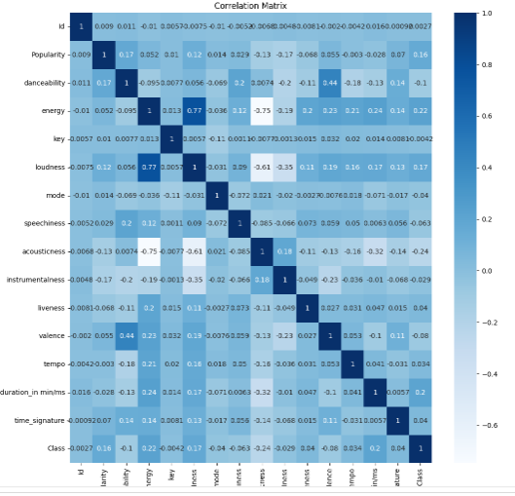
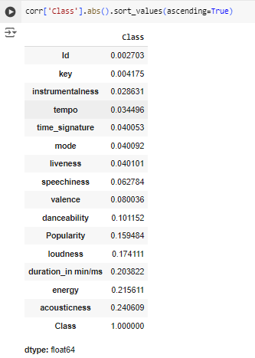
Visualize The Correlations between numerical features with target (class)

Slide 11
Prepare the data
03

Slide 12
1
1
2
3
4
5
6
Feature Engineering
create a new
feature
Encoder
Encoder:
for Artist Name
and Track Name
Split Data
Into test&train
test size = 0.25
Missing values
Clean data with fill all missing values
outliers
Outliers all feature by interquartile
range
Scaling
Apply StandardScaler
on features

Slide 13
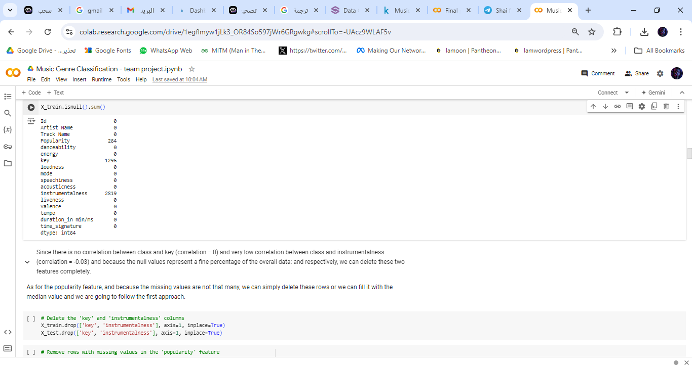
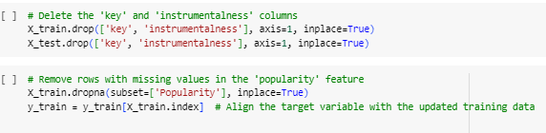
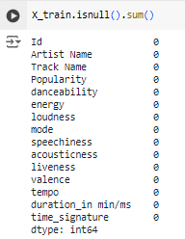
Missing values
Dealing With Missing value by dropping those columns which contain amount of null values
After Dealing with null values

Slide 14
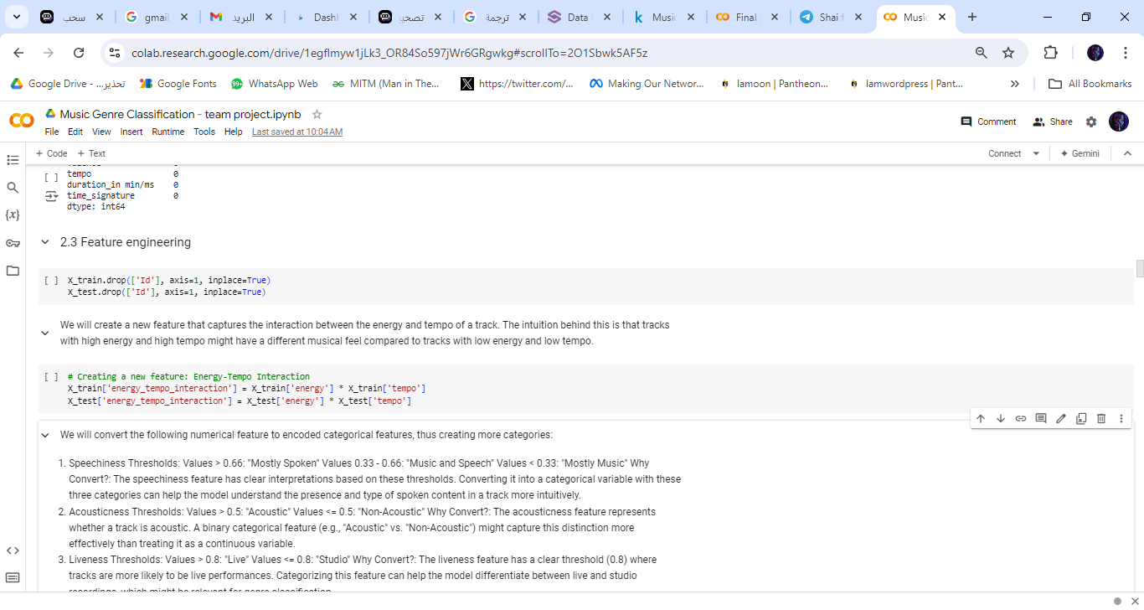
Feature Engineering
We create a new feature that captures the interaction between the energy and tempo of a track. The intuition behind this is that tracks with high energy and high tempo might have a different musical feel compared to tracks with low energy and low tempo also we drop id that has low correlation with Class column

Slide 15
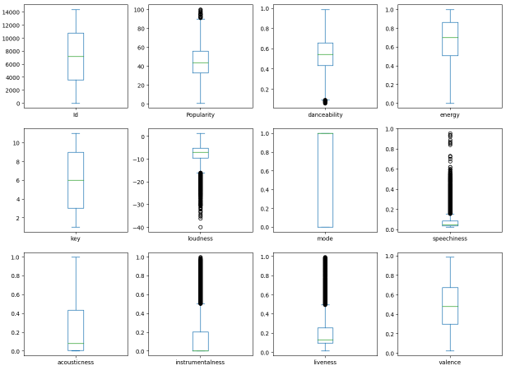
Outliers

Slide 16
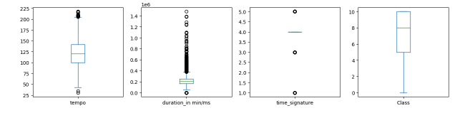
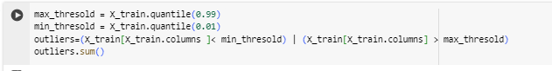
Outliers
Thresholds Definition: We calculates the upper (max_threshold which is usually 0.99 ) and lower (min_threshold and it is usually 0.01 ) limits using the 99th and 1st percentiles of the training dataset, respectively.
Outlier Detection: It identifies outliers by checking for values that fall below the lower threshold or above the upper threshold.
Counting Outliers: The total number of outliers is calculated using outliers.sum().

Slide 17
Converting to categorical features
We will convert the following numerical feature to encoded categorical features, thus creating more categories: 1. Speechiness
2.Acousticness
3.Liveness
Advantages of converting to categorical:
Interpretability: The model might better understand specific categories (e.g., "Live" vs. "Studio") rather than trying to interpret the raw continuous values. Reduced
Complexity: Categorical variables can simplify the model, making it easier to interpret and less prone to overfitting, especially in tree-based models.

Slide 18
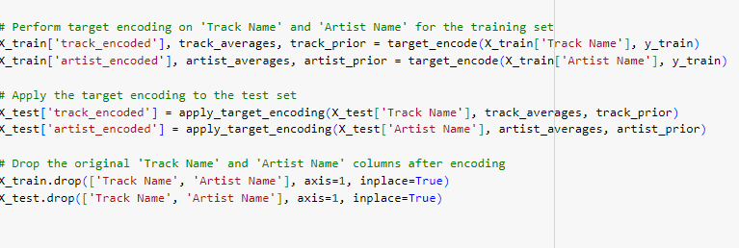
Encoding categorical features(Track/Artist Name)
Perform target encoding on a given categorical feature using the training set.
Applies the same encoding to the test set.

Slide 19
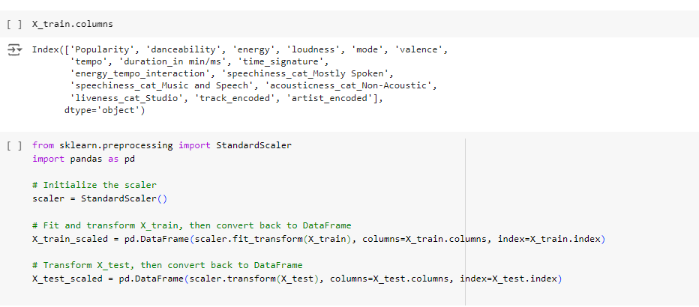
Normalization/Standraization
For our model we use here the Standard Scaler
For all the numerical features
And here is the result:

Slide 20
Train different models
Evaluation Metric The evaluation metric for this competition is Root Mean Squared Error (F1-score).
The F1-score can be interpreted as a harmonic mean of the precision and recall.
F1 = 2 * (precision * recall) / (precision + recall)
Decisson tree
classiefer
Logistic
Regression
K nearest Neighbors
Classifier

Slide 21
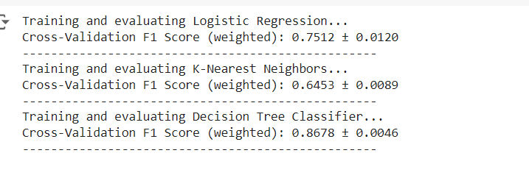
Train different models
The score of training different models:

Slide 22
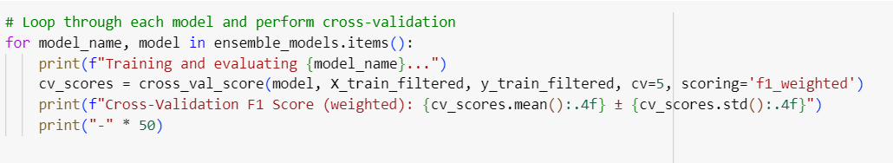
Train With ensemble models
HistGradient
Boosting Classifier
Random
Forest
Classifier
Soft voting
classifier
XGB
Classifier
Hard voting
classifier

Slide 23
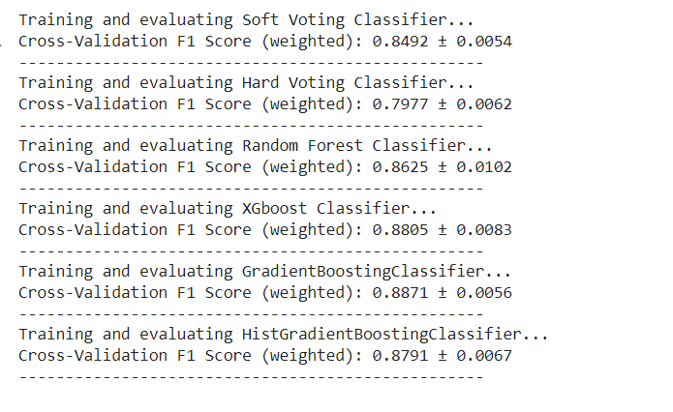
Train different models
Training with ensemble Models results:

Slide 24
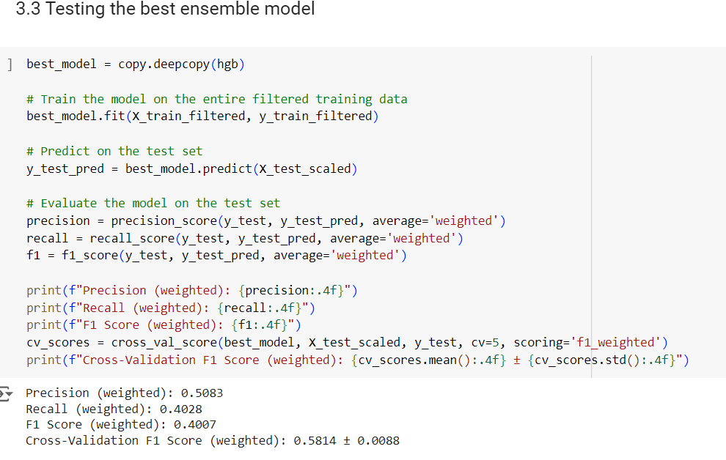
Testing the best ensamble model
The best ensemble Models results:

Slide 25
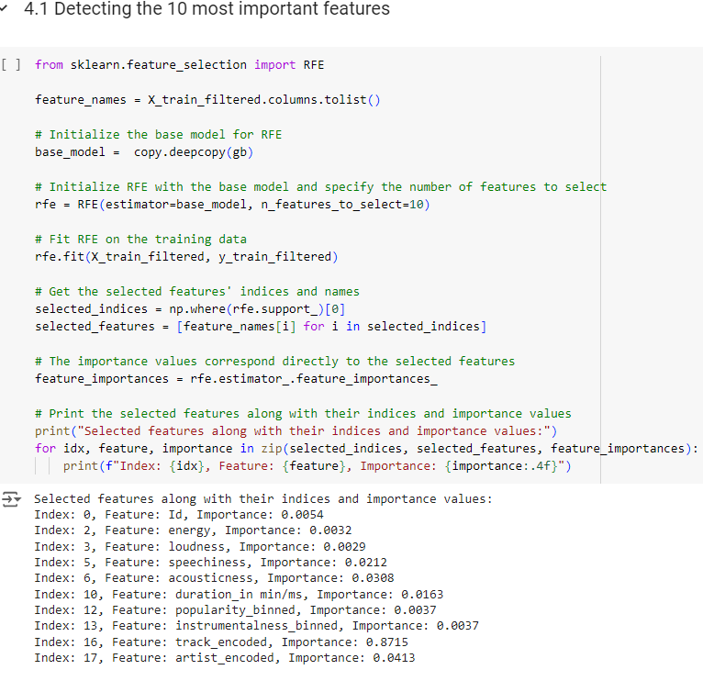
Feature selection:
We detect the most 10 important features: It seems that the track_encoded feature has a major importance which means it might be causing overfitting the data, so we will get rid of it

Slide 26
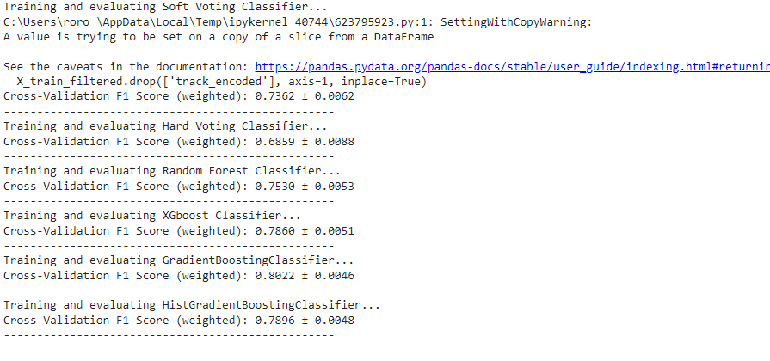
Training the best model without RFE

Slide 27
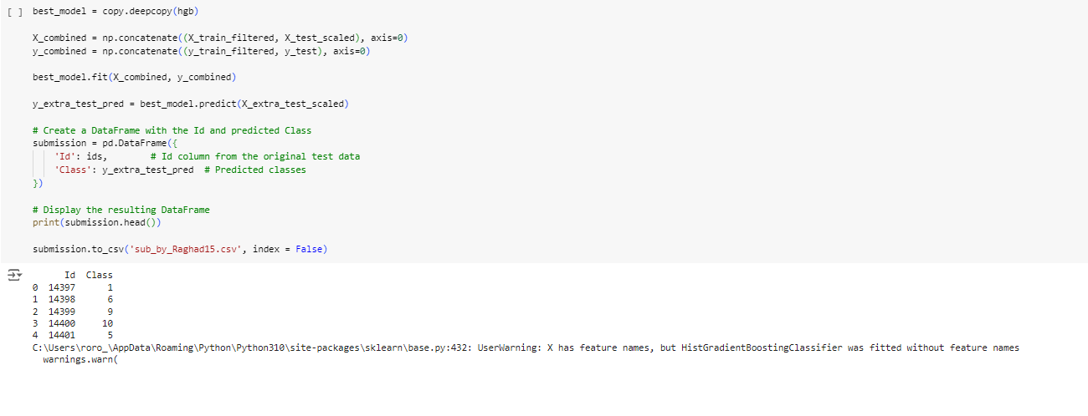
The best model is: Hist Gradient Boosting Classifier without features selection

Slide 28
Thanks!

